Slide 1
Maximum

Slide 2
Maximum . instruction
.section .data # starting with period means assembler
# instructions and not machine code
data_items:
.long 3, 67, 222, 45, 0 # array of longs, 5 x 4 bytes = 20 bytes
.section .text # where instructions live
.globl _start # tell program to start at _start
_start:
movl $0, %edi # move 0 into the index register
movl data_items(,%edi,4), %eax # load 1st byte of data
movl %eax, %ebx # 1st loop so %eax is the largest
start_loop:
cmpl $0, %eax # check to see if end of data
je loop_exit # jump if equal
incl %edi # increase index
movl data_items(,%edi,4), %eax # load next byte of data
cmpl %ebx, %eax # compare values
jle start_loop # jump back if new value is smaller
movl %eax, %ebx # save value as the largest
jmp start_loop # jump back
loop_exit:
movl $1, %eax # 1 is exit code, EBX is status code
int $0x80 # interrupt 16

Slide 3
Maximum array
.section .data # starting with period means assembler
# instructions and not machine code
data_items:
.long 3, 67, 222, 45, 0 # array of longs, 5 x 4 bytes = 20 bytes
.section .text # where instructions live
.globl _start # tell program to start at _start
_start:
movl $0, %edi # move 0 into the index register
movl data_items(,%edi,4), %eax # load 1st byte of data
movl %eax, %ebx # 1st loop so %eax is the largest
start_loop:
cmpl $0, %eax # check to see if end of data
je loop_exit # jump if equal
incl %edi # increase index
movl data_items(,%edi,4), %eax # load next byte of data
cmpl %ebx, %eax # compare values
jle start_loop # jump back if new value is smaller
movl %eax, %ebx # save value as the largest
jmp start_loop # jump back
loop_exit:
movl $1, %eax # 1 is exit code, EBX is status code
int $0x80 # interrupt 16

Slide 4
Maximum .text
.section .data # starting with period means assembler
# instructions and not machine code
data_items:
.long 3, 67, 222, 45, 0 # array of longs, 5 x 4 bytes = 20 bytes
.section .text # where instructions live
.globl _start # tell program to start at _start
_start:
movl $0, %edi # move 0 into the index register
movl data_items(,%edi,4), %eax # load 1st byte of data
movl %eax, %ebx # 1st loop so %eax is the largest
start_loop:
cmpl $0, %eax # check to see if end of data
je loop_exit # jump if equal
incl %edi # increase index
movl data_items(,%edi,4), %eax # load next byte of data
cmpl %ebx, %eax # compare values
jle start_loop # jump back if new value is smaller
movl %eax, %ebx # save value as the largest
jmp start_loop # jump back
loop_exit:
movl $1, %eax # 1 is exit code, EBX is status code
int $0x80 # interrupt 16

Slide 5
Maximum .globl _start
.section .data # starting with period means assembler
# instructions and not machine code
data_items:
.long 3, 67, 222, 45, 0 # array of longs, 5 x 4 bytes = 20 bytes
.section .text # where instructions live
.globl _start # tell program to start at _start
_start:
movl $0, %edi # move 0 into the index register
movl data_items(,%edi,4), %eax # load 1st byte of data
movl %eax, %ebx # 1st loop so %eax is the largest
start_loop:
cmpl $0, %eax # check to see if end of data
je loop_exit # jump if equal
incl %edi # increase index
movl data_items(,%edi,4), %eax # load next byte of data
cmpl %ebx, %eax # compare values
jle start_loop # jump back if new value is smaller
movl %eax, %ebx # save value as the largest
jmp start_loop # jump back
loop_exit:
movl $1, %eax # 1 is exit code, EBX is status code
int $0x80 # interrupt 16

Slide 6
Maximum i = 0
.section .data # starting with period means assembler
# instructions and not machine code
data_items:
.long 3, 67, 222, 45, 0 # array of longs, 5 x 4 bytes = 20 bytes
.section .text # where instructions live
.globl _start # tell program to start at _start
_start:
movl $0, %edi # move 0 into the index register
movl data_items(,%edi,4), %eax # load 1st byte of data
movl %eax, %ebx # 1st loop so %eax is the largest
start_loop:
cmpl $0, %eax # check to see if end of data
je loop_exit # jump if equal
incl %edi # increase index
movl data_items(,%edi,4), %eax # load next byte of data
cmpl %ebx, %eax # compare values
jle start_loop # jump back if new value is smaller
movl %eax, %ebx # save value as the largest
jmp start_loop # jump back
loop_exit:
movl $1, %eax # 1 is exit code, EBX is status code
int $0x80 # interrupt 16
EDI = 0

Slide 7
Maximum i = 0
.section .data # starting with period means assembler
# instructions and not machine code
data_items:
.long 3, 67, 222, 45, 0 # array of longs, 5 x 4 bytes = 20 bytes
.section .text # where instructions live
.globl _start # tell program to start at _start
_start:
movl $0, %edi # move 0 into the index register
movl data_items(,%edi,4), %eax # load 1st byte of data
movl %eax, %ebx # 1st loop so %eax is the largest
start_loop:
cmpl $0, %eax # check to see if end of data
je loop_exit # jump if equal
incl %edi # increase index
movl data_items(,%edi,4), %eax # load next byte of data
cmpl %ebx, %eax # compare values
jle start_loop # jump back if new value is smaller
movl %eax, %ebx # save value as the largest
jmp start_loop # jump back
loop_exit:
movl $1, %eax # 1 is exit code, EBX is status code
int $0x80 # interrupt 16
EDI = 0
EAX = 3

Slide 8
Maximum i = 0
.section .data # starting with period means assembler
# instructions and not machine code
data_items:
.long 3, 67, 222, 45, 0 # array of longs, 5 x 4 bytes = 20 bytes
.section .text # where instructions live
.globl _start # tell program to start at _start
_start:
movl $0, %edi # move 0 into the index register
movl data_items(,%edi,4), %eax # load 1st byte of data
movl %eax, %ebx # 1st loop so %eax is the largest
start_loop:
cmpl $0, %eax # check to see if end of data
je loop_exit # jump if equal
incl %edi # increase index
movl data_items(,%edi,4), %eax # load next byte of data
cmpl %ebx, %eax # compare values
jle start_loop # jump back if new value is smaller
movl %eax, %ebx # save value as the largest
jmp start_loop # jump back
loop_exit:
movl $1, %eax # 1 is exit code, EBX is status code
int $0x80 # interrupt 16
EDI = 0
EAX = 3
EBX = 3

Slide 9
Maximum end?
.section .data # starting with period means assembler
# instructions and not machine code
data_items:
.long 3, 67, 222, 45, 0 # array of longs, 5 x 4 bytes = 20 bytes
.section .text # where instructions live
.globl _start # tell program to start at _start
_start:
movl $0, %edi # move 0 into the index register
movl data_items(,%edi,4), %eax # load 1st byte of data
movl %eax, %ebx # 1st loop so %eax is the largest
start_loop:
cmpl $0, %eax # check to see if end of data
je loop_exit # jump if equal
incl %edi # increase index
movl data_items(,%edi,4), %eax # load next byte of data
cmpl %ebx, %eax # compare values
jle start_loop # jump back if new value is smaller
movl %eax, %ebx # save value as the largest
jmp start_loop # jump back
loop_exit:
movl $1, %eax # 1 is exit code, EBX is status code
int $0x80 # interrupt 16
EDI = 0
EAX = 3
EBX = 3

Slide 10
Maximum i = 1
.section .data # starting with period means assembler
# instructions and not machine code
data_items:
.long 3, 67, 222, 45, 0 # array of longs, 5 x 4 bytes = 20 bytes
.section .text # where instructions live
.globl _start # tell program to start at _start
_start:
movl $0, %edi # move 0 into the index register
movl data_items(,%edi,4), %eax # load 1st byte of data
movl %eax, %ebx # 1st loop so %eax is the largest
start_loop:
cmpl $0, %eax # check to see if end of data
je loop_exit # jump if equal
incl %edi # increase index
movl data_items(,%edi,4), %eax # load next byte of data
cmpl %ebx, %eax # compare values
jle start_loop # jump back if new value is smaller
movl %eax, %ebx # save value as the largest
jmp start_loop # jump back
loop_exit:
movl $1, %eax # 1 is exit code, EBX is status code
int $0x80 # interrupt 16
EDI = 1
EAX = 3
EBX = 3

Slide 11
Maximum i = 1
.section .data # starting with period means assembler
# instructions and not machine code
data_items:
.long 3, 67, 222, 45, 0 # array of longs, 5 x 4 bytes = 20 bytes
.section .text # where instructions live
.globl _start # tell program to start at _start
_start:
movl $0, %edi # move 0 into the index register
movl data_items(,%edi,4), %eax # load 1st byte of data
movl %eax, %ebx # 1st loop so %eax is the largest
start_loop:
cmpl $0, %eax # check to see if end of data
je loop_exit # jump if equal
incl %edi # increase index
movl data_items(,%edi,4), %eax # load next byte of data
cmpl %ebx, %eax # compare values
jle start_loop # jump back if new value is smaller
movl %eax, %ebx # save value as the largest
jmp start_loop # jump back
loop_exit:
movl $1, %eax # 1 is exit code, EBX is status code
int $0x80 # interrupt 16
EDI = 1
EAX = 67
EBX = 3

Slide 12
Maximum largest ? array[1]
.section .data # starting with period means assembler
# instructions and not machine code
data_items:
.long 3, 67, 222, 45, 0 # array of longs, 5 x 4 bytes = 20 bytes
.section .text # where instructions live
.globl _start # tell program to start at _start
_start:
movl $0, %edi # move 0 into the index register
movl data_items(,%edi,4), %eax # load 1st byte of data
movl %eax, %ebx # 1st loop so %eax is the largest
start_loop:
cmpl $0, %eax # check to see if end of data
je loop_exit # jump if equal
incl %edi # increase index
movl data_items(,%edi,4), %eax # load next byte of data
cmpl %ebx, %eax # compare values
jle start_loop # jump back if new value is smaller
movl %eax, %ebx # save value as the largest
jmp start_loop # jump back
loop_exit:
movl $1, %eax # 1 is exit code, EBX is status code
int $0x80 # interrupt 16
EDI = 1
EAX = 67
EBX = 3

Slide 13
Maximum largest = array[1]
.section .data # starting with period means assembler
# instructions and not machine code
data_items:
.long 3, 67, 222, 45, 0 # array of longs, 5 x 4 bytes = 20 bytes
.section .text # where instructions live
.globl _start # tell program to start at _start
_start:
movl $0, %edi # move 0 into the index register
movl data_items(,%edi,4), %eax # load 1st byte of data
movl %eax, %ebx # 1st loop so %eax is the largest
start_loop:
cmpl $0, %eax # check to see if end of data
je loop_exit # jump if equal
incl %edi # increase index
movl data_items(,%edi,4), %eax # load next byte of data
cmpl %ebx, %eax # compare values
jle start_loop # jump back if new value is smaller
movl %eax, %ebx # save value as the largest
jmp start_loop # jump back
loop_exit:
movl $1, %eax # 1 is exit code, EBX is status code
int $0x80 # interrupt 16
EDI = 1
EAX = 67
EBX = 3

Slide 14
Maximum restart loop
.section .data # starting with period means assembler
# instructions and not machine code
data_items:
.long 3, 67, 222, 45, 0 # array of longs, 5 x 4 bytes = 20 bytes
.section .text # where instructions live
.globl _start # tell program to start at _start
_start:
movl $0, %edi # move 0 into the index register
movl data_items(,%edi,4), %eax # load 1st byte of data
movl %eax, %ebx # 1st loop so %eax is the largest
start_loop:
cmpl $0, %eax # check to see if end of data
je loop_exit # jump if equal
incl %edi # increase index
movl data_items(,%edi,4), %eax # load next byte of data
cmpl %ebx, %eax # compare values
jle start_loop # jump back if new value is smaller
movl %eax, %ebx # save value as the largest
jmp start_loop # jump back
loop_exit:
movl $1, %eax # 1 is exit code, EBX is status code
int $0x80 # interrupt 16
EDI = 1
EAX = 67
EBX = 67

Slide 15
Maximum end?
.section .data # starting with period means assembler
# instructions and not machine code
data_items:
.long 3, 67, 222, 45, 0 # array of longs, 5 x 4 bytes = 20 bytes
.section .text # where instructions live
.globl _start # tell program to start at _start
_start:
movl $0, %edi # move 0 into the index register
movl data_items(,%edi,4), %eax # load 1st byte of data
movl %eax, %ebx # 1st loop so %eax is the largest
start_loop:
cmpl $0, %eax # check to see if end of data
je loop_exit # jump if equal
incl %edi # increase index
movl data_items(,%edi,4), %eax # load next byte of data
cmpl %ebx, %eax # compare values
jle start_loop # jump back if new value is smaller
movl %eax, %ebx # save value as the largest
jmp start_loop # jump back
loop_exit:
movl $1, %eax # 1 is exit code, EBX is status code
int $0x80 # interrupt 16
EDI = 1
EAX = 67
EBX = 67

Slide 16
Maximum i = 2
.section .data # starting with period means assembler
# instructions and not machine code
data_items:
.long 3, 67, 222, 45, 0 # array of longs, 5 x 4 bytes = 20 bytes
.section .text # where instructions live
.globl _start # tell program to start at _start
_start:
movl $0, %edi # move 0 into the index register
movl data_items(,%edi,4), %eax # load 1st byte of data
movl %eax, %ebx # 1st loop so %eax is the largest
start_loop:
cmpl $0, %eax # check to see if end of data
je loop_exit # jump if equal
incl %edi # increase index
movl data_items(,%edi,4), %eax # load next byte of data
cmpl %ebx, %eax # compare values
jle start_loop # jump back if new value is smaller
movl %eax, %ebx # save value as the largest
jmp start_loop # jump back
loop_exit:
movl $1, %eax # 1 is exit code, EBX is status code
int $0x80 # interrupt 16
EDI = 2
EAX = 67
EBX = 67

Slide 17
Maximum i = 2
.section .data # starting with period means assembler
# instructions and not machine code
data_items:
.long 3, 67, 222, 45, 0 # array of longs, 5 x 4 bytes = 20 bytes
.section .text # where instructions live
.globl _start # tell program to start at _start
_start:
movl $0, %edi # move 0 into the index register
movl data_items(,%edi,4), %eax # load 1st byte of data
movl %eax, %ebx # 1st loop so %eax is the largest
start_loop:
cmpl $0, %eax # check to see if end of data
je loop_exit # jump if equal
incl %edi # increase index
movl data_items(,%edi,4), %eax # load next byte of data
cmpl %ebx, %eax # compare values
jle start_loop # jump back if new value is smaller
movl %eax, %ebx # save value as the largest
jmp start_loop # jump back
loop_exit:
movl $1, %eax # 1 is exit code, EBX is status code
int $0x80 # interrupt 16
EDI = 2
EAX = 222
EBX = 67

Slide 18
Maximum largest ? array[2]
.section .data # starting with period means assembler
# instructions and not machine code
data_items:
.long 3, 67, 222, 45, 0 # array of longs, 5 x 4 bytes = 20 bytes
.section .text # where instructions live
.globl _start # tell program to start at _start
_start:
movl $0, %edi # move 0 into the index register
movl data_items(,%edi,4), %eax # load 1st byte of data
movl %eax, %ebx # 1st loop so %eax is the largest
start_loop:
cmpl $0, %eax # check to see if end of data
je loop_exit # jump if equal
incl %edi # increase index
movl data_items(,%edi,4), %eax # load next byte of data
cmpl %ebx, %eax # compare values
jle start_loop # jump back if new value is smaller
movl %eax, %ebx # save value as the largest
jmp start_loop # jump back
loop_exit:
movl $1, %eax # 1 is exit code, EBX is status code
int $0x80 # interrupt 16
EDI = 2
EAX = 222
EBX = 67

Slide 19
Maximum largest = array[2]
.section .data # starting with period means assembler
# instructions and not machine code
data_items:
.long 3, 67, 222, 45, 0 # array of longs, 5 x 4 bytes = 20 bytes
.section .text # where instructions live
.globl _start # tell program to start at _start
_start:
movl $0, %edi # move 0 into the index register
movl data_items(,%edi,4), %eax # load 1st byte of data
movl %eax, %ebx # 1st loop so %eax is the largest
start_loop:
cmpl $0, %eax # check to see if end of data
je loop_exit # jump if equal
incl %edi # increase index
movl data_items(,%edi,4), %eax # load next byte of data
cmpl %ebx, %eax # compare values
jle start_loop # jump back if new value is smaller
movl %eax, %ebx # save value as the largest
jmp start_loop # jump back
loop_exit:
movl $1, %eax # 1 is exit code, EBX is status code
int $0x80 # interrupt 16.se
EDI = 2
EAX = 222
EBX = 222

Slide 20
Maximum restart loop
.section .data # starting with period means assembler
# instructions and not machine code
data_items:
.long 3, 67, 222, 45, 0 # array of longs, 5 x 4 bytes = 20 bytes
.section .text # where instructions live
.globl _start # tell program to start at _start
_start:
movl $0, %edi # move 0 into the index register
movl data_items(,%edi,4), %eax # load 1st byte of data
movl %eax, %ebx # 1st loop so %eax is the largest
start_loop:
cmpl $0, %eax # check to see if end of data
je loop_exit # jump if equal
incl %edi # increase index
movl data_items(,%edi,4), %eax # load next byte of data
cmpl %ebx, %eax # compare values
jle start_loop # jump back if new value is smaller
movl %eax, %ebx # save value as the largest
jmp start_loop # jump back
loop_exit:
movl $1, %eax # 1 is exit code, EBX is status code
int $0x80 # interrupt 16
EDI = 2
EAX = 222
EBX = 222

Slide 21
Maximum end?
.section .data # starting with period means assembler
# instructions and not machine code
data_items:
.long 3, 67, 222, 45, 0 # array of longs, 5 x 4 bytes = 20 bytes
.section .text # where instructions live
.globl _start # tell program to start at _start
_start:
movl $0, %edi # move 0 into the index register
movl data_items(,%edi,4), %eax # load 1st byte of data
movl %eax, %ebx # 1st loop so %eax is the largest
start_loop:
cmpl $0, %eax # check to see if end of data
je loop_exit # jump if equal
incl %edi # increase index
movl data_items(,%edi,4), %eax # load next byte of data
cmpl %ebx, %eax # compare values
jle start_loop # jump back if new value is smaller
movl %eax, %ebx # save value as the largest
jmp start_loop # jump back
loop_exit:
movl $1, %eax # 1 is exit code, EBX is status code
int $0x80 # interrupt 16
EDI = 2
EAX = 222
EBX = 222

Slide 22
Maximum i = 3
.section .data # starting with period means assembler
# instructions and not machine code
data_items:
.long 3, 67, 222, 45, 0 # array of longs, 5 x 4 bytes = 20 bytes
.section .text # where instructions live
.globl _start # tell program to start at _start
_start:
movl $0, %edi # move 0 into the index register
movl data_items(,%edi,4), %eax # load 1st byte of data
movl %eax, %ebx # 1st loop so %eax is the largest
start_loop:
cmpl $0, %eax # check to see if end of data
je loop_exit # jump if equal
incl %edi # increase index
movl data_items(,%edi,4), %eax # load next byte of data
cmpl %ebx, %eax # compare values
jle start_loop # jump back if new value is smaller
movl %eax, %ebx # save value as the largest
jmp start_loop # jump back
loop_exit:
movl $1, %eax # 1 is exit code, EBX is status code
int $0x80 # interrupt 16
EDI = 3
EAX = 222
EBX = 222

Slide 23
Maximum i = 3
.section .data # starting with period means assembler
# instructions and not machine code
data_items:
.long 3, 67, 222, 45, 0 # array of longs, 5 x 4 bytes = 20 bytes
.section .text # where instructions live
.globl _start # tell program to start at _start
_start:
movl $0, %edi # move 0 into the index register
movl data_items(,%edi,4), %eax # load 1st byte of data
movl %eax, %ebx # 1st loop so %eax is the largest
start_loop:
cmpl $0, %eax # check to see if end of data
je loop_exit # jump if equal
incl %edi # increase index
movl data_items(,%edi,4), %eax # load next byte of data
cmpl %ebx, %eax # compare values
jle start_loop # jump back if new value is smaller
movl %eax, %ebx # save value as the largest
jmp start_loop # jump back
loop_exit:
movl $1, %eax # 1 is exit code, EBX is status code
int $0x80 # interrupt 16
EDI = 3
EAX = 45
EBX = 222

Slide 24
Maximum largest ? array[3]
.section .data # starting with period means assembler
# instructions and not machine code
data_items:
.long 3, 67, 222, 45, 0 # array of longs, 5 x 4 bytes = 20 bytes
.section .text # where instructions live
.globl _start # tell program to start at _start
_start:
movl $0, %edi # move 0 into the index register
movl data_items(,%edi,4), %eax # load 1st byte of data
movl %eax, %ebx # 1st loop so %eax is the largest
start_loop:
cmpl $0, %eax # check to see if end of data
je loop_exit # jump if equal
incl %edi # increase index
movl data_items(,%edi,4), %eax # load next byte of data
cmpl %ebx, %eax # compare values
jle start_loop # jump back if new value is smaller
movl %eax, %ebx # save value as the largest
jmp start_loop # jump back
loop_exit:
movl $1, %eax # 1 is exit code, EBX is status code
int $0x80 # interrupt 16
EDI = 3
EAX = 45
EBX = 222

Slide 25
Maximum ignore
.section .data # starting with period means assembler
# instructions and not machine code
data_items:
.long 3, 67, 222, 45, 0 # array of longs, 5 x 4 bytes = 20 bytes
.section .text # where instructions live
.globl _start # tell program to start at _start
_start:
movl $0, %edi # move 0 into the index register
movl data_items(,%edi,4), %eax # load 1st byte of data
movl %eax, %ebx # 1st loop so %eax is the largest
start_loop:
cmpl $0, %eax # check to see if end of data
je loop_exit # jump if equal
incl %edi # increase index
movl data_items(,%edi,4), %eax # load next byte of data
cmpl %ebx, %eax # compare values
jle start_loop # jump back if new value is smaller
movl %eax, %ebx # save value as the largest
jmp start_loop # jump back
loop_exit:
movl $1, %eax # 1 is exit code, EBX is status code
int $0x80 # interrupt 16
EDI = 3
EAX = 45
EBX = 222

Slide 26
Maximum end?
.section .data # starting with period means assembler
# instructions and not machine code
data_items:
.long 3, 67, 222, 45, 0 # array of longs, 5 x 4 bytes = 20 bytes
.section .text # where instructions live
.globl _start # tell program to start at _start
_start:
movl $0, %edi # move 0 into the index register
movl data_items(,%edi,4), %eax # load 1st byte of data
movl %eax, %ebx # 1st loop so %eax is the largest
start_loop:
cmpl $0, %eax # check to see if end of data
je loop_exit # jump if equal
incl %edi # increase index
movl data_items(,%edi,4), %eax # load next byte of data
cmpl %ebx, %eax # compare values
jle start_loop # jump back if new value is smaller
movl %eax, %ebx # save value as the largest
jmp start_loop # jump back
loop_exit:
movl $1, %eax # 1 is exit code, EBX is status code
int $0x80 # interrupt 16
EDI = 3
EAX = 45
EBX = 222

Slide 27
Maximum i = 4
.section .data # starting with period means assembler
# instructions and not machine code
data_items:
.long 3, 67, 222, 45, 0 # array of longs, 5 x 4 bytes = 20 bytes
.section .text # where instructions live
.globl _start # tell program to start at _start
_start:
movl $0, %edi # move 0 into the index register
movl data_items(,%edi,4), %eax # load 1st byte of data
movl %eax, %ebx # 1st loop so %eax is the largest
start_loop:
cmpl $0, %eax # check to see if end of data
je loop_exit # jump if equal
incl %edi # increase index
movl data_items(,%edi,4), %eax # load next byte of data
cmpl %ebx, %eax # compare values
jle start_loop # jump back if new value is smaller
movl %eax, %ebx # save value as the largest
jmp start_loop # jump back
loop_exit:
movl $1, %eax # 1 is exit code, EBX is status code
int $0x80 # interrupt 16
EDI = 4
EAX = 45
EBX = 222

Slide 28
Maximum i = 4
.section .data # starting with period means assembler
# instructions and not machine code
data_items:
.long 3, 67, 222, 45, 0 # array of longs, 5 x 4 bytes = 20 bytes
.section .text # where instructions live
.globl _start # tell program to start at _start
_start:
movl $0, %edi # move 0 into the index register
movl data_items(,%edi,4), %eax # load 1st byte of data
movl %eax, %ebx # 1st loop so %eax is the largest
start_loop:
cmpl $0, %eax # check to see if end of data
je loop_exit # jump if equal
incl %edi # increase index
movl data_items(,%edi,4), %eax # load next byte of data
cmpl %ebx, %eax # compare values
jle start_loop # jump back if new value is smaller
movl %eax, %ebx # save value as the largest
jmp start_loop # jump back
loop_exit:
movl $1, %eax # 1 is exit code, EBX is status code
int $0x80 # interrupt 16
EDI = 4
EAX = 0
EBX = 222

Slide 29
Maximum largest ? array[4]
.section .data # starting with period means assembler
# instructions and not machine code
data_items:
.long 3, 67, 222, 45, 0 # array of longs, 5 x 4 bytes = 20 bytes
.section .text # where instructions live
.globl _start # tell program to start at _start
_start:
movl $0, %edi # move 0 into the index register
movl data_items(,%edi,4), %eax # load 1st byte of data
movl %eax, %ebx # 1st loop so %eax is the largest
start_loop:
cmpl $0, %eax # check to see if end of data
je loop_exit # jump if equal
incl %edi # increase index
movl data_items(,%edi,4), %eax # load next byte of data
cmpl %ebx, %eax # compare values
jle start_loop # jump back if new value is smaller
movl %eax, %ebx # save value as the largest
jmp start_loop # jump back
loop_exit:
movl $1, %eax # 1 is exit code, EBX is status code
int $0x80 # interrupt 16
EDI = 4
EAX = 0
EBX = 222

Slide 30
Maximum restart loop
.section .data # starting with period means assembler
# instructions and not machine code
data_items:
.long 3, 67, 222, 45, 0 # array of longs, 5 x 4 bytes = 20 bytes
.section .text # where instructions live
.globl _start # tell program to start at _start
_start:
movl $0, %edi # move 0 into the index register
movl data_items(,%edi,4), %eax # load 1st byte of data
movl %eax, %ebx # 1st loop so %eax is the largest
start_loop:
cmpl $0, %eax # check to see if end of data
je loop_exit # jump if equal
incl %edi # increase index
movl data_items(,%edi,4), %eax # load next byte of data
cmpl %ebx, %eax # compare values
jle start_loop # jump back if new value is smaller
movl %eax, %ebx # save value as the largest
jmp start_loop # jump back
loop_exit:
movl $1, %eax # 1 is exit code, EBX is status code
int $0x80 # interrupt 16
EDI = 4
EAX = 0
EBX = 222

Slide 31
Maximum end?
.section .data # starting with period means assembler
# instructions and not machine code
data_items:
.long 3, 67, 222, 45, 0 # array of longs, 5 x 4 bytes = 20 bytes
.section .text # where instructions live
.globl _start # tell program to start at _start
_start:
movl $0, %edi # move 0 into the index register
movl data_items(,%edi,4), %eax # load 1st byte of data
movl %eax, %ebx # 1st loop so %eax is the largest
start_loop:
cmpl $0, %eax # check to see if end of data
je loop_exit # jump if equal
incl %edi # increase index
movl data_items(,%edi,4), %eax # load next byte of data
cmpl %ebx, %eax # compare values
jle start_loop # jump back if new value is smaller
movl %eax, %ebx # save value as the largest
jmp start_loop # jump back
loop_exit:
movl $1, %eax # 1 is exit code, EBX is status code
int $0x80 # interrupt 16
EDI = 4
EAX = 0
EBX = 222

Slide 32
Maximum end!
.section .data # starting with period means assembler
# instructions and not machine code
data_items:
.long 3, 67, 222, 45, 0 # array of longs, 5 x 4 bytes = 20 bytes
.section .text # where instructions live
.globl _start # tell program to start at _start
_start:
movl $0, %edi # move 0 into the index register
movl data_items(,%edi,4), %eax # load 1st byte of data
movl %eax, %ebx # 1st loop so %eax is the largest
start_loop:
cmpl $0, %eax # check to see if end of data
je loop_exit # jump if equal
incl %edi # increase index
movl data_items(,%edi,4), %eax # load next byte of data
cmpl %ebx, %eax # compare values
jle start_loop # jump back if new value is smaller
movl %eax, %ebx # save value as the largest
jmp start_loop # jump back
loop_exit:
movl $1, %eax # 1 is exit code, EBX is status code
int $0x80 # interrupt 16
EDI = 4
EAX = 0
EBX = 222

Slide 33
Maximum exit code = 1; return value = 222
.section .data # starting with period means assembler
# instructions and not machine code
data_items:
.long 3, 67, 222, 45, 0 # array of longs, 5 x 4 bytes = 20 bytes
.section .text # where instructions live
.globl _start # tell program to start at _start
_start:
movl $0, %edi # move 0 into the index register
movl data_items(,%edi,4), %eax # load 1st byte of data
movl %eax, %ebx # 1st loop so %eax is the largest
start_loop:
cmpl $0, %eax # check to see if end of data
je loop_exit # jump if equal
incl %edi # increase index
movl data_items(,%edi,4), %eax # load next byte of data
cmpl %ebx, %eax # compare values
jle start_loop # jump back if new value is smaller
movl %eax, %ebx # save value as the largest
jmp start_loop # jump back
loop_exit:
movl $1, %eax # 1 is exit code, EBX is status code
int $0x80 # interrupt 16
EDI = 4
EAX = 1
EBX = 222

Slide 34
Maximum interrupt
.section .data # starting with period means assembler
# instructions and not machine code
data_items:
.long 3, 67, 222, 45, 0 # array of longs, 5 x 4 bytes = 20 bytes
.section .text # where instructions live
.globl _start # tell program to start at _start
_start:
movl $0, %edi # move 0 into the index register
movl data_items(,%edi,4), %eax # load 1st byte of data
movl %eax, %ebx # 1st loop so %eax is the largest
start_loop:
cmpl $0, %eax # check to see if end of data
je loop_exit # jump if equal
incl %edi # increase index
movl data_items(,%edi,4), %eax # load next byte of data
cmpl %ebx, %eax # compare values
jle start_loop # jump back if new value is smaller
movl %eax, %ebx # save value as the largest
jmp start_loop # jump back
loop_exit:
movl $1, %eax # 1 is exit code, EBX is status code
int $0x80 # interrupt 16
EDI = 4
EAX = 1
EBX = 222

Slide 35
Maximum Answer
222
EDI = 4
EAX = 1
EBX = 222
data_items:
.long 3, 67, 222, 45, 0

Slide 36
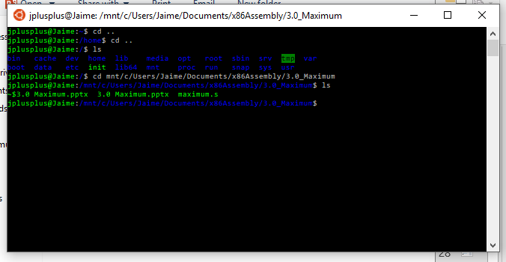
Maximum Bash on Ubuntu on Windows: navigate to maximum.s

Slide 37
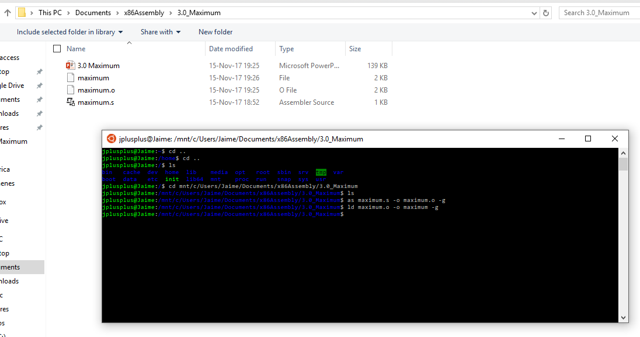
Maximum Bash: assemble and link

Slide 38
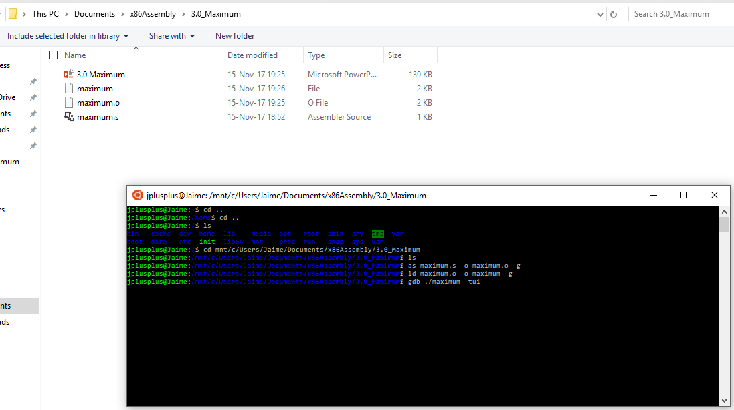
Maximum Bash: gdb tui

Slide 39
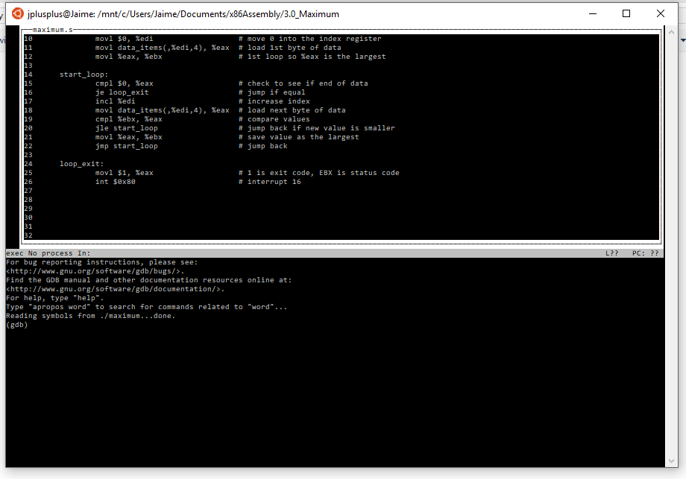
Maximum gdb tui

Slide 40
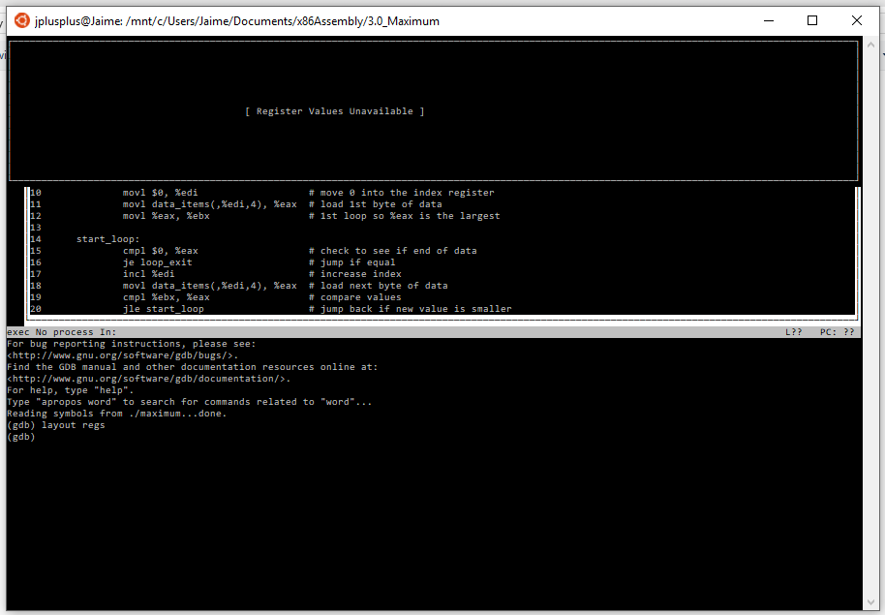
Maximum gdbtui: registers

Slide 41
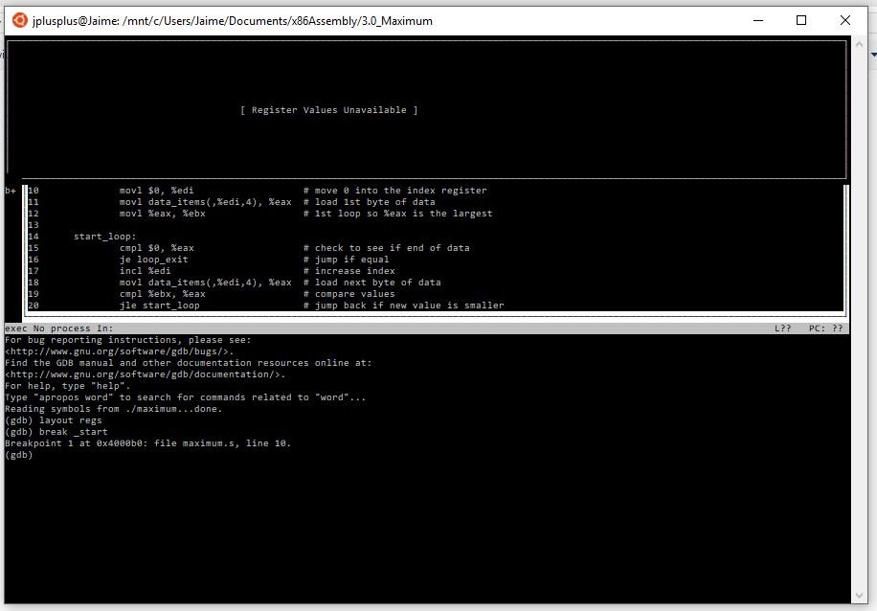
Maximum gdbtui: breakpoints

Slide 42
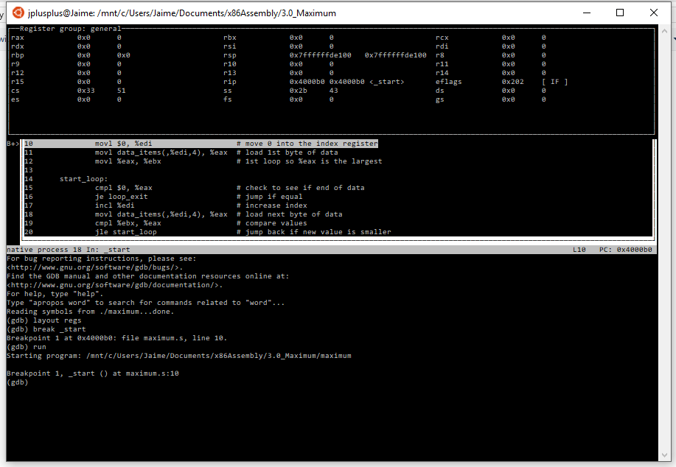
Maximum gdbtui: run

Slide 43
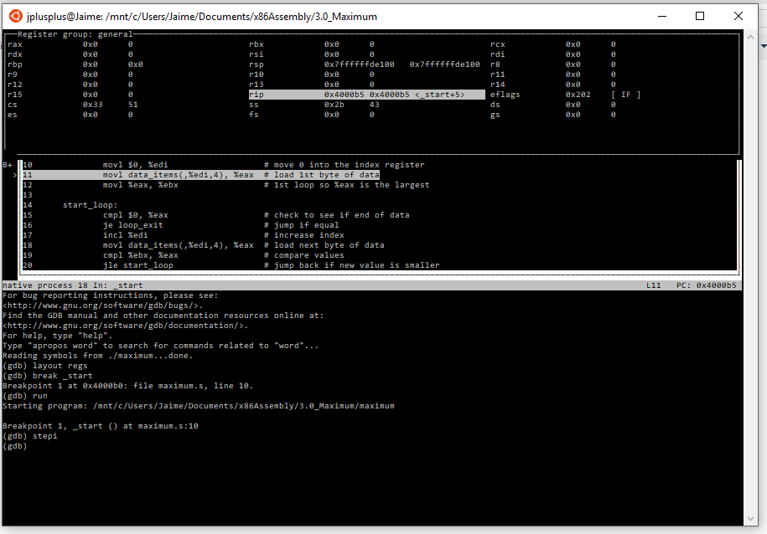
Maximum gdbtui: step into

Slide 44
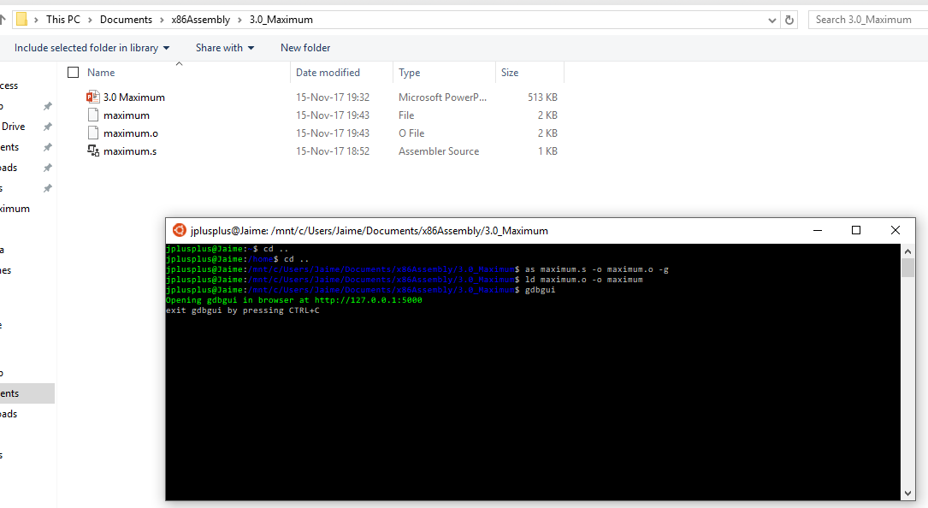
Maximum Bash: gdbgui

Slide 45
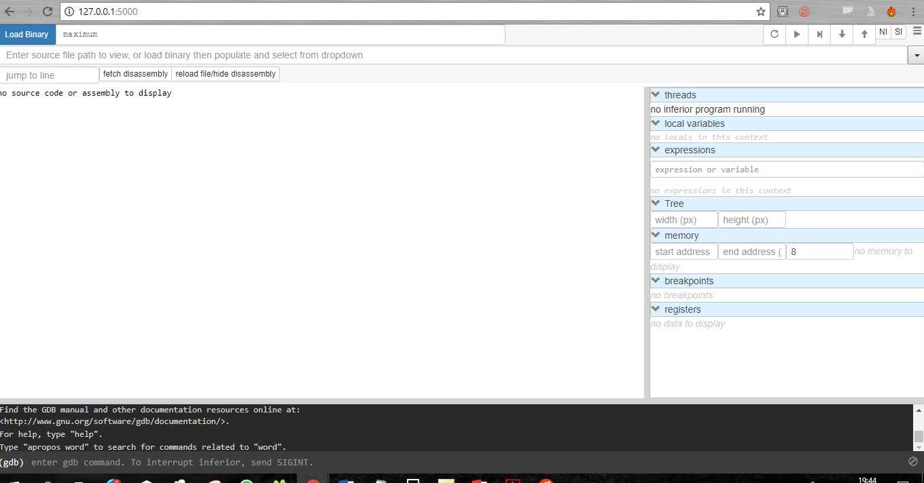
Maximum gdbgui

Slide 46
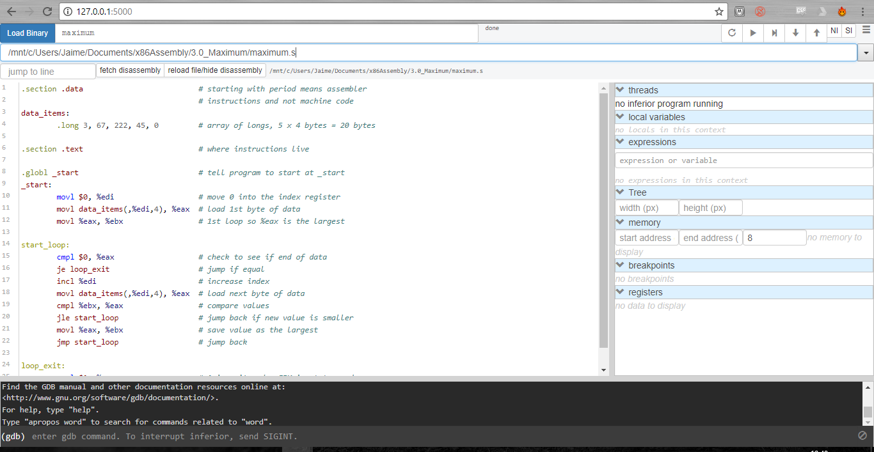
Maximum gdbgui: maximum.s

Slide 47
Maximum gdbgui: maximum.s

Slide 48
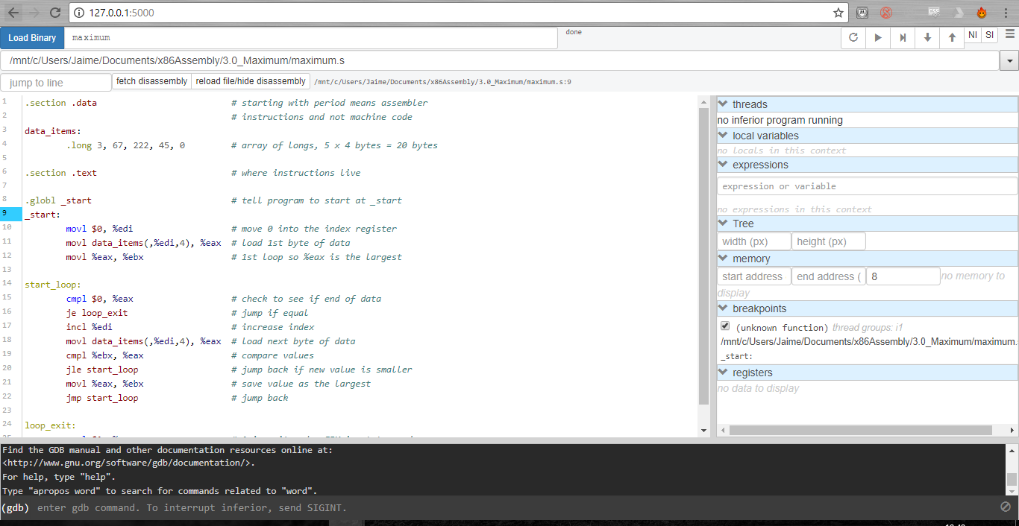
Maximum gdbgui: breakpoints

Slide 49
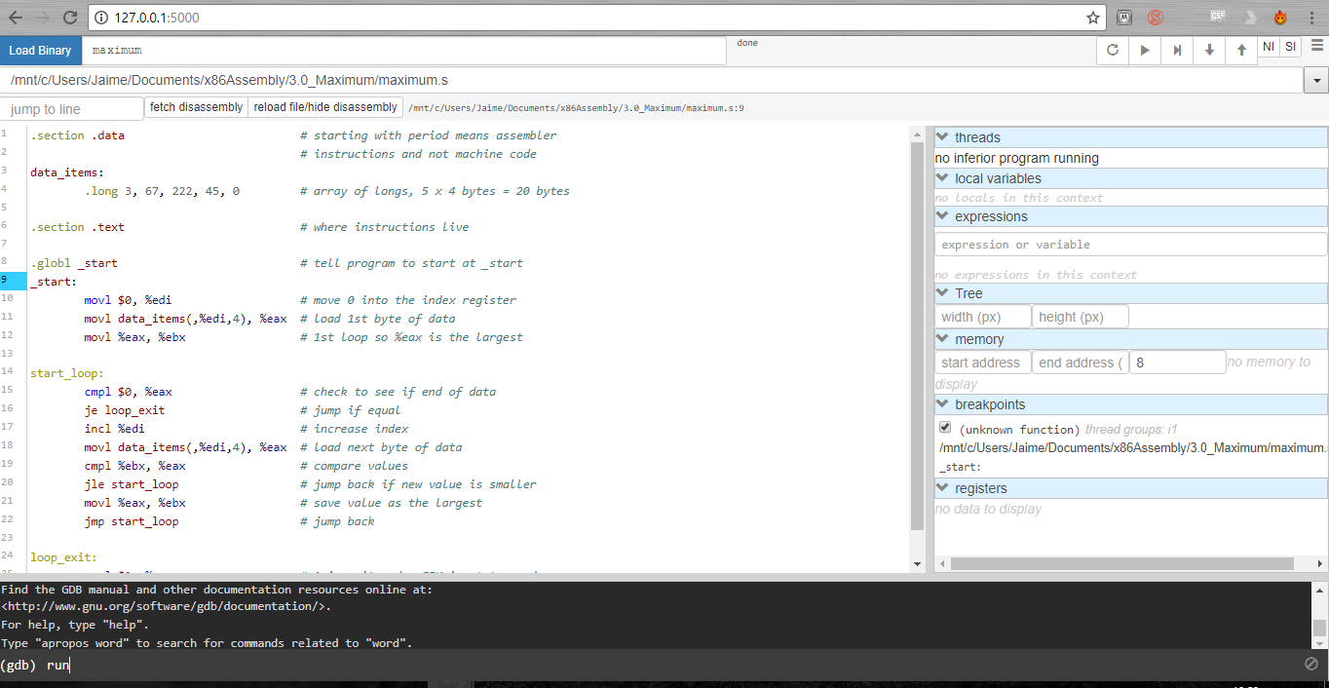
Maximum gdbgui: run

Slide 50
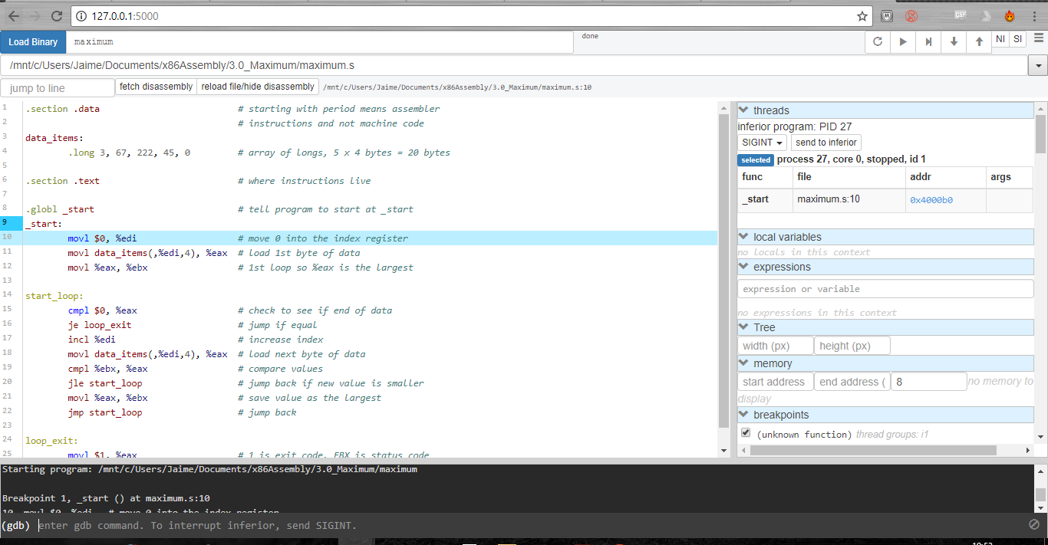
Maximum gdbgui: step into

Slide 51
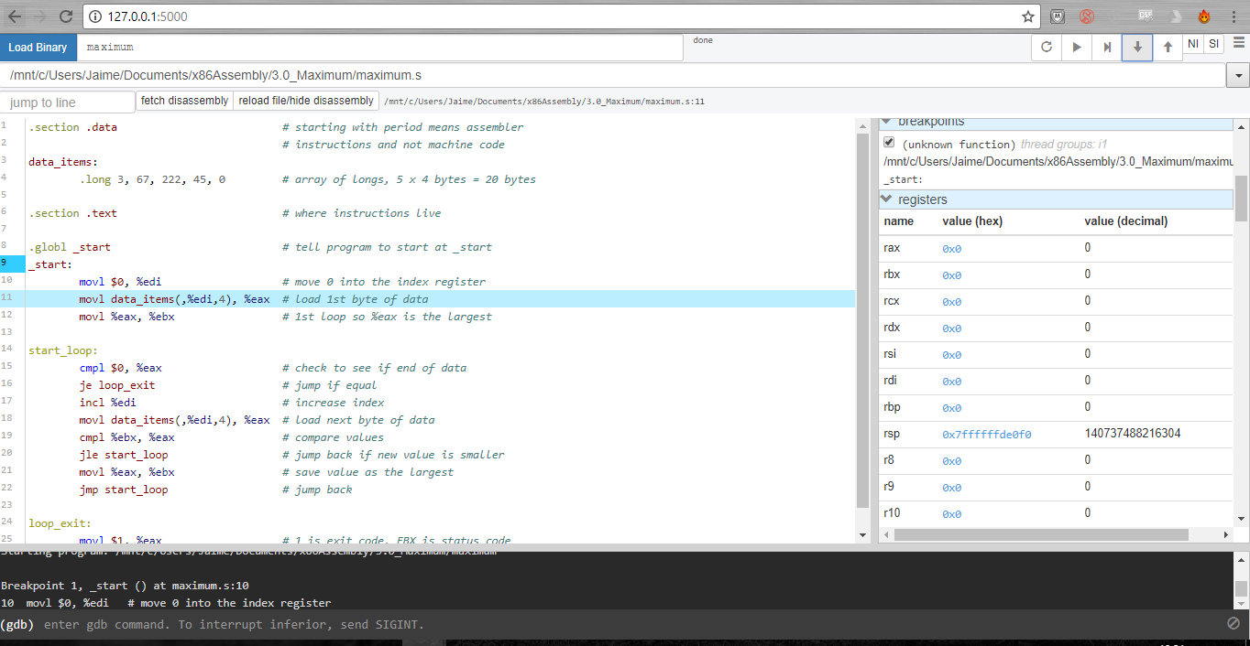
Maximum gdbgui: registers

